Slide 1


Carrier Frequency Offset in OFDM System

Slide 2
Outline
Introduction Timing Offset (TO)
Carrier Frequency Offset (CFO)
Frequency Offset Estimation With Fast Acquisition
Solved Examples
➢
➢
➢
➢
➢

Slide 3
Outline
Introduction Timing Offset (TO)
Carrier Frequency Offset (CFO)
Frequency Offset Estimation With Fast Acquisition
Solved Exmples
➢
➢
➢
➢
➢

Slide 4
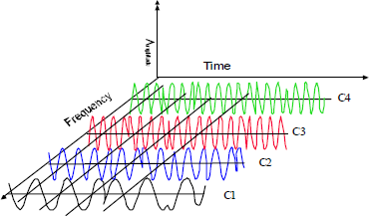
Introduction
▪Multicarrier Amplitude modulation scheme.
▪ Each carrier’s amplitude is modulated.
▪Carriers are spaced evenly and orthogonally(can be computed efficiently with IDFT and DFT.
▪Idea is to split the signal into multiple smaller sub-signals
that are transmitted simultaneously.
OFDM signal in Time and Frequency domain

Slide 5
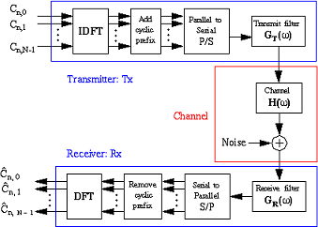
Introduction
▪
ADVANTAGES
•
Immunity to Frequency selective fading
Resilience to interference Robust to narrow-band interference
Spectrum efficiency
•
•
•
▪
DISADVANTAGES
•
Sensitivity to synchronization errors
High Peak-to-average power ratio
•
Block Diagram of OFDM Symbol
Thus , OFDM can provide large data rates with sufficient robustness to radio channel impairment ,therefor a popular choice for wireless broadband communication(Adopted in WiFi , WiMax ,DAB , DVB, LTE & LTA-A )
5

Slide 6
Introduction
•
Impairment in OFDM
• Symbol Timing Offset (TO)
• Due to the unknown transmission time or propagation delay of OFDM symbol at receiver
•
Carrier Frequency Offset (CFO)
• Frequency differences between the transmitter and receiver oscillator
• Oscillator instabilities
• Doppler shift of mobile channels
• Phase noise
• Sampling Clock Offset
These errors cause Inter symbol Interference(ISI) and Inter carrier Interference(ICI)
6

Slide 7
Introduction Timing Offset
➢
➢
Carrier Frequency Offset
Frequency Offset Estimation With Fast Acquisition
References
➢
➢
➢
7

Slide 8


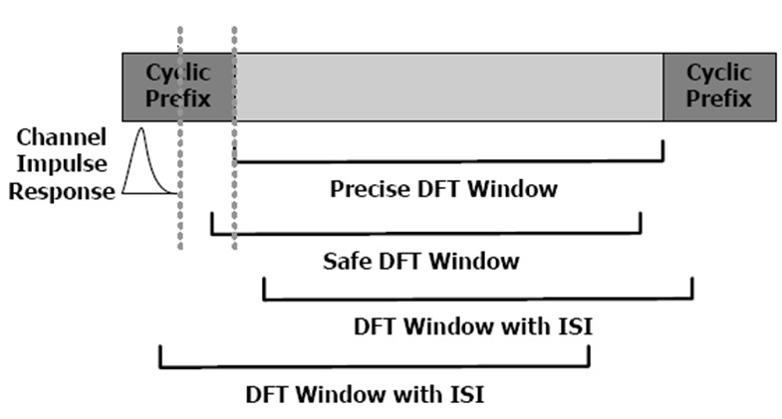
Timing Offset
➢
Window overlapping of the two successive OFDM symbols raises to ISI
•
Due to incorrect position of the FFT window at receiver for Start Symbol.
➢
Introduces Inter-symbol Interference(ISI) and phase shift to the desired symbol components.
➢
(TO) can be avoided by keeping the window start point within the ISI free region of cyclic prefix (CP) for each symbol.
Larger the CP, the more TO , a system can tolerate.
➢
8

Slide 9
Timing Offset Estimator
➢
GOAL : To determine the start symbol position at receiver to avoid the ISI and ICI.
▪
Pilot Based Method : (useful for systems with low SNR)
• Pilots (pseudo-random sequences or null symbols) can be used to determine the start of an OFDM symbol.
Pilot-symbols can be OFDM based or Non-OFDM based.
•
In case of continuous data , a null signal is appropriate , for bursty data this is not true.
▪
Non-Pilot based Method :
• Most method exploits the redundancy of cyclic-prefix(CF) to find the start symbol position.
Some algorithms use the periodicity of the correlation function of the time domain OFDM symbol.
•

Slide 10
Introduction Timing Offset
➢
➢
Carrier Frequency Offset
Frequency Offset Estimation With Fast Acquisition
Solved Examples
➢
➢
➢

Slide 11
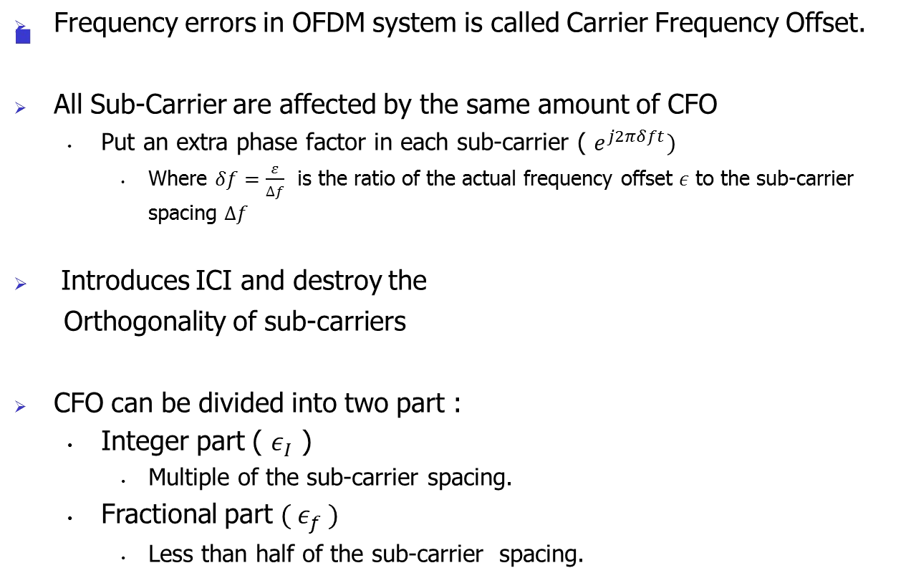
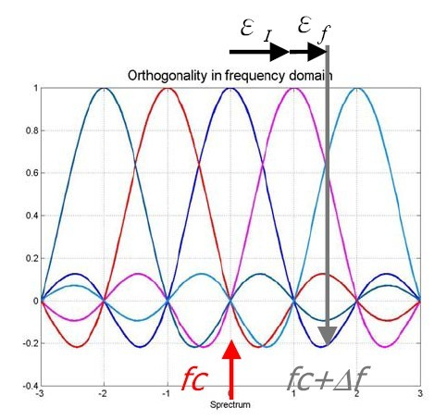
Carrier Frequency Offset

Slide 12
Carrier Frequency Offset
➢
Integer CFO :
• Do not introduces ICI between sub-carrier spacing but introduces a cyclic shift of data sub-carriers and a phase change proportional to OFDM symbol number. No effect on orthogonality.
In Acquisition phase, we estimate the Integer CFO (also called Coarse Frequency Offset Estimation)
Acquisition scheme generally have a wide range , but low accuracy.(Usually fast acquisition is required)
•
•
•
➢
Fractional CFO :
• Causes rotation and introduces ICI between sub-carriers, (destroy the orthogonality
of sub-carrier ,results in BER degradation).
• In Tracking phase, we usually estimate Fractional CFO (also called Fine Frequency Offset Estimation).
• Tracking algorithm have a narrower range but fine accuracy.

Slide 13

Carrier Frequency Offset
➢
The OFDM system model with CFO :
S ( k )
S/P
Signal Mapper
X ( k )
Adding Pilots C(n)& IFFT
x(n)
Adding Cyclic Prefix & P/S
x ( t )
DAC
Channel h ( t)
z (t )
_{e} j 2πδ _{f} n₀ / N _{δ = ε / Δ f}
f
AWGN w ( t)
S^{ˆ} (k)
P/S
Signal Demapper
R(k)
FFT
r(n) | Remove Cyclic Prefix & S/P
r (t )
ADC

Slide 14
Carrier Frequency Offset Estimator
➢
CFO Estimation Methods :
▪
Data Aided (Use of Pilots or training symbols , cause reduction in throughput as known data pattern also needs to send)
Non-Data Aided (Use of the Intrinsic structure of OFDM symbols e.g. exploits the redundancy in Cyclic-Prefix)
Blind Approaches (No data overhead but very high computational complexity and relies on the signal statistics)
▪
▪
➢
Frequency synchronization Steps in OFDM :
I. Finding the correct Integer Offset
II. Finding a coarse estimate of the fractional frequency offset.
III. Refining the obtained fractional frequency offset.

Slide 15
Carrier Frequency Offset Estimator
➢
GOAL : To refine the initial analog estimate of the carrier frequency
▪ Pilot Based Method :
• can be used for both Integer and Fractional carrier frequency
synchronization
• Pilot can be an extra sequence outside an OFDM symbol or known data interspersed with the OFDM symbol.
• Both OFDM based and non-OFDM based pilots can be used
▪ Non-Pilot based Method :
▪
▪
Generally used for Fractional frequency synchronization. Redundancy in the cyclic-prefix (CP) is used for frequency offset estimation.
Very similar to the pilot based method except that this method rely on the correlation within the OFDM symbol rather than adding known pilot symbols.
▪
15

Slide 16
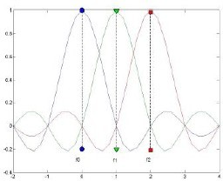
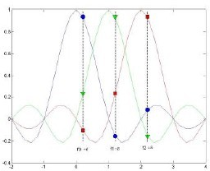
• Carrier Frequency Offset Estimator
Frequency Synchronization can be categorized into :
➢
▪
Pre-FFT Synchronization
•
i.e. estimation is performed before computation of DFT at receiver so require less computing power and provides fast synchronization
▪
Post-FFT Synchronization
i.e. estimation is performed after computing the DFT.
•
Without CFO
With CFO

Slide 17
Solved Examples
Consider Design of a Point-to-Point link connecting LANs in separate buildings across a freeway of Distance .25 mile with a Line of Sight (LOS) communication in a Unlicensed spectrum – 802.11b at 2.4GHz and the Maximum transmit power of 802.11 AP is P_{t} = 24 dBm ,The minimum received signal strength (RSS) for 11 Mbps operation is -80 dBm .Will the signal strength be adequate for communication?
Solution
Given LOS
Distance .25 mile ~ 400m; Receiver Sensitivity Threshold = - 80dBm
The Received Power P_{r} is given by
P_{r} = P_{t} - Path Loss
P_{r} = P_{t} - 21.98 + 20 log₁₀ ( ) – 20 log10 (d)
= 24 – 21.98 + 20 log₁₀ (3x10⁸/2.4x10⁹) – 20 log₁₀ (400)
= 24 -21.98 -18.06 -52.04
= 24 – 92.08
= -68.08 dBm
P_{r} is well above the required -80 dBm for communication at the maximum data rate – so link should work fine
20

Slide 18
In a Hata’s Model Consider the parameters receiver antenna’s height to be h_{re} = 2 m, transmitter antenna’s height h_{te} = 100 m carrier frequency f_{c} = 900 MHz, The path loss exponent for this particular case is = 3.18 Find the the path loss at d = 5 km and If the maximum allowed path loss is 120 dB, what distance can the signal travel?
Solution
d = 5 km
L_{p} = 118.14 + logd
L_{p} = 118.14 + 31.8 log 5
= 140.36 dB
If the maximum allowed path loss is 120 dB, what distance can the signal travel?
L_{p} = 120 = 118.14 + 31.8 log d => d = 10 ^{(1.86/31.8)} = 1.14 km

Slide 19
for example, in a multicarrier system B equals let us say 10 megahertz and the number of sub bands equals N = 1000 calculate the bandwidth per sub band and symbol time in each sub band.
Solution
B=10Mhz
N=1000
Bandwidth of each sub band =B/N=10*10³/1000=10Khz
Symbol Time in each sub frame isT= 1/B/N=N/B
=1/10Khz=0.1ms or 100 micro sec

